Slide 1
12-04-2024
Prepared by:
Sambad Rupakheti
Sagar Dhital
Olanrewaju Alaba
Axay Prakashbhai Patel
Jainish Patel
Analysis of Stroke Prediction Dataset

Slide 2
Project Summary
Objective: Demonstrate the ability to acquire, store, and analyze data to provide actionable insights
Focus: Remote data acquisition, secure storage, and exploratory data analysis
Tools Used: Python, AWS RDS (PostgreSQL), Pandas, Matplotlib

Slide 3
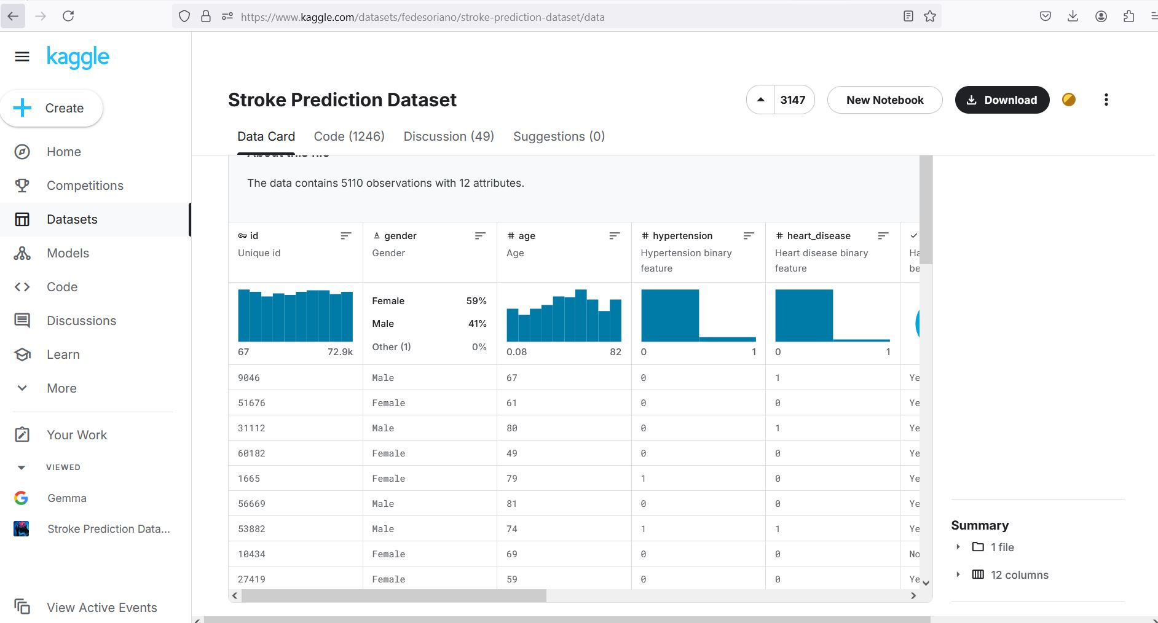
Dataset Overview
Data Source: The dataset was sourced from Kaggle, focusing on healthcare-related stroke prediction.
Number of Observations: The dataset includes 5,110 rows, each representing an individual.
Features: The dataset contains 12 attributes, including:
Demographics: Gender, Age, Residence Type.
Health Conditions: Hypertension, Heart Disease.
Lifestyle Factors: Smoking Status.
Measurements: BMI, Average Glucose Level.
Target Variable: Stroke Status.

Slide 4
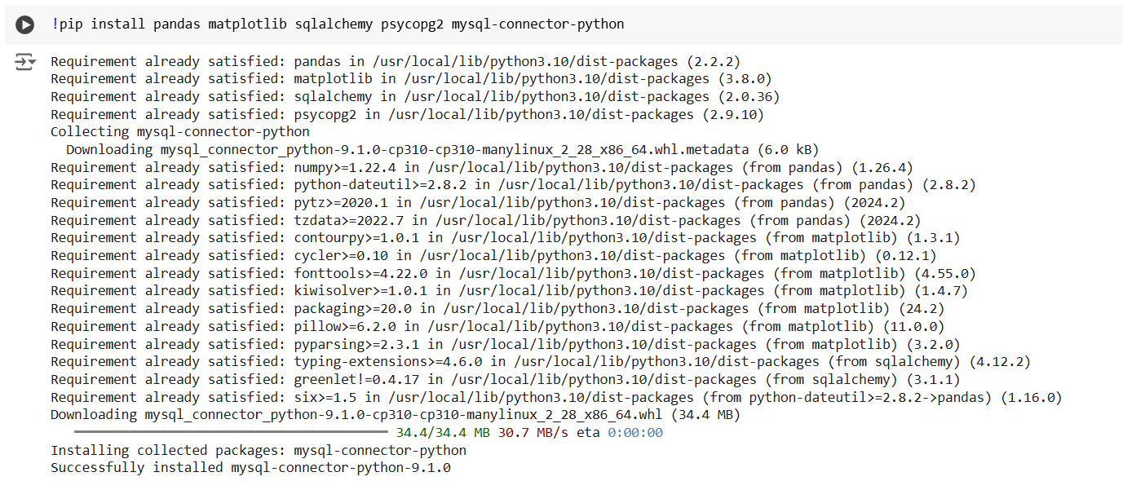
Data Acquisition
Dataset Source: Stroke prediction dataset from Kaggle
Steps Taken:
Imported data via URL into Python using Pandas
Verified data structure and quality

Slide 5
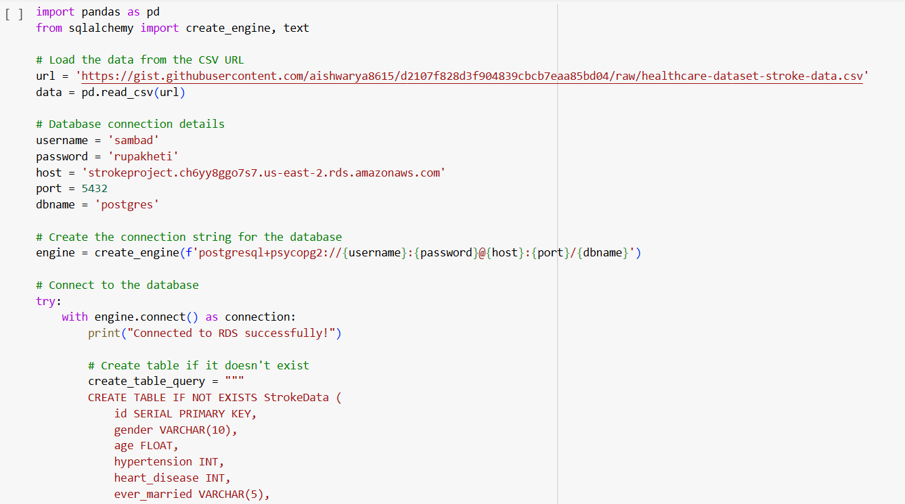
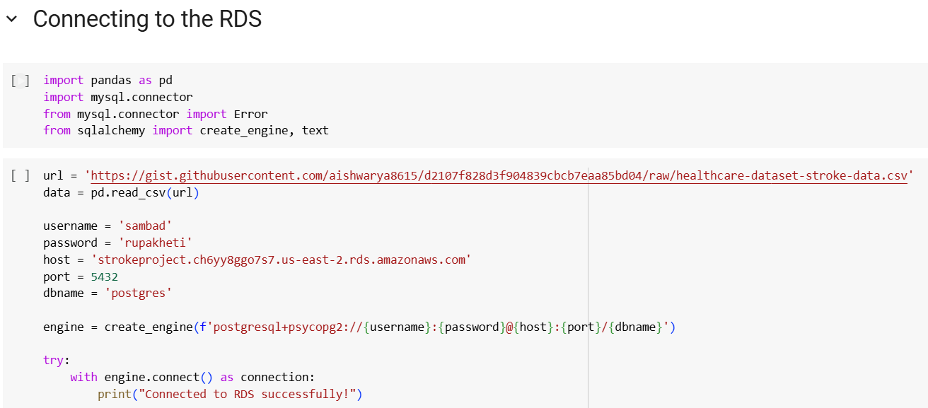
Storing Data on AWS RDS
Database Used: AWS RDS (PostgreSQL).
Steps Taken:
Connected to AWS RDS using SQLAlchemy.
Created StrokeData table in PostgreSQL.
Uploaded dataset to the database.

Slide 6
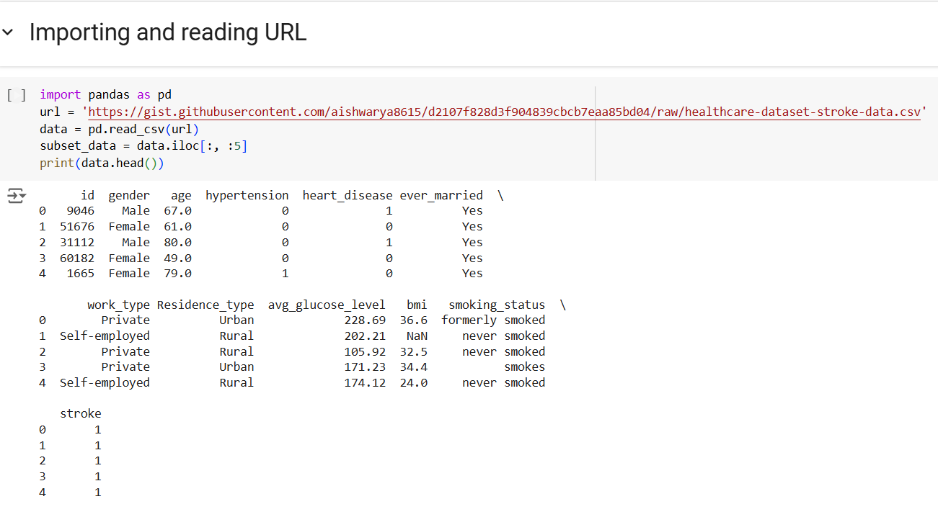
Initial Data Exploration
Objective: Understand the dataset through exploration.
Insights:
Columns include id, gender, age, hypertension, heart_disease, etc.
A quick preview shows the first five rows of the dataset.

Slide 7
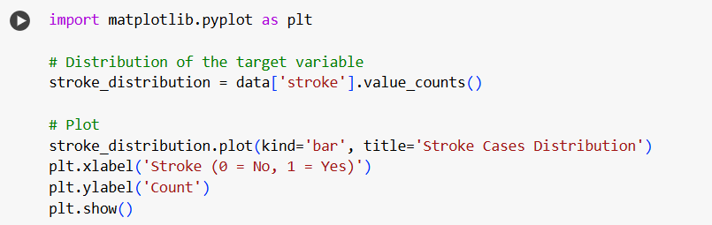
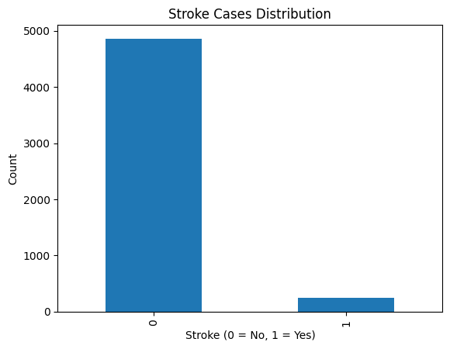
Distribution of Stroke Cases
Insights:
The majority of cases fall under the non-stroke category (0).
The disparity highlights the importance of focusing on the minority (stroke cases) for preventive measures.
Visualization:
A bar chart displaying the distribution of stroke cases, categorized as:
0 (No Stroke): Represents individuals who did not experience a stroke.
1 (Yes Stroke): Represents individuals who experienced a stroke.

Slide 8
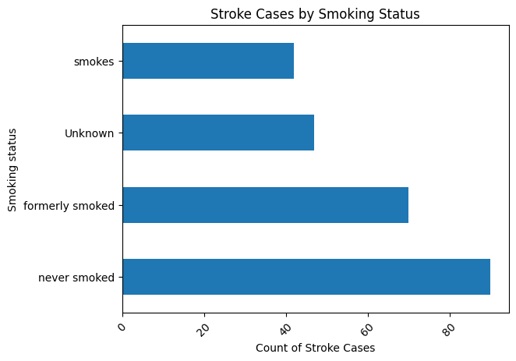
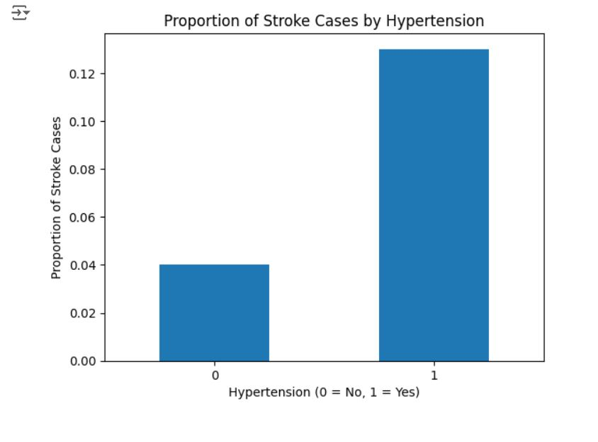
Factors Contributing to Stroke
Smoking Status:
Bar chart depicting the distribution of stroke cases by smoking status:
Categories: Never Smoked, Formerly Smoked, Smokes.
Insight:
Higher stroke cases were observed in individuals who never smoked or formerly smoked, compared to active smokers.
Hypertension:
Bar chart showcasing the proportion of stroke cases in:
Hypertensive (1) individuals vs. Non-Hypertensive (0) individuals.
Insight:
Hypertension significantly increases stroke risk, with a proportion of 13% compared to 4% for non-hypertensive individuals.

Slide 9
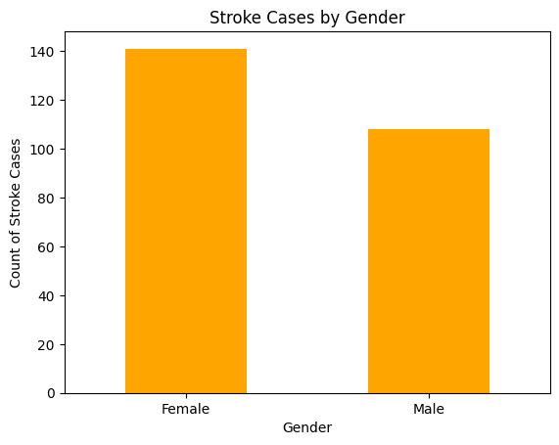
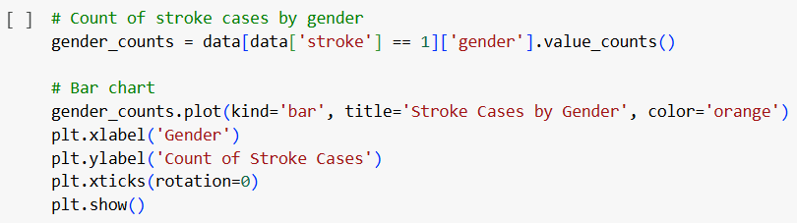
Factors Contributing to Stroke
Gender:
Bar chart comparing stroke cases by gender:
Male vs. Female.
Insight:
Stroke occurrences are slightly higher among females, suggesting potential gender-specific health implications.

Slide 10
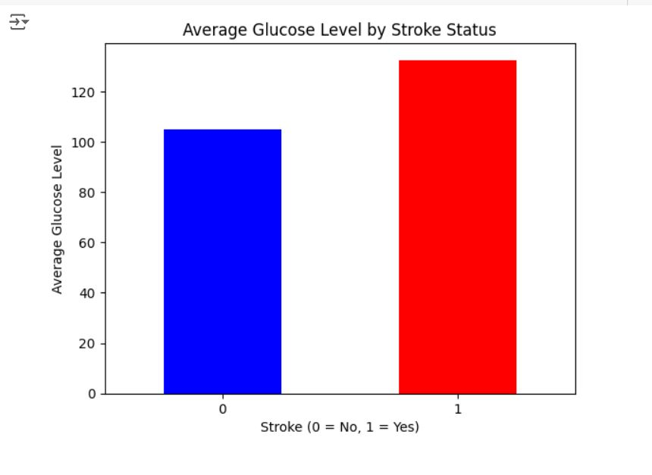
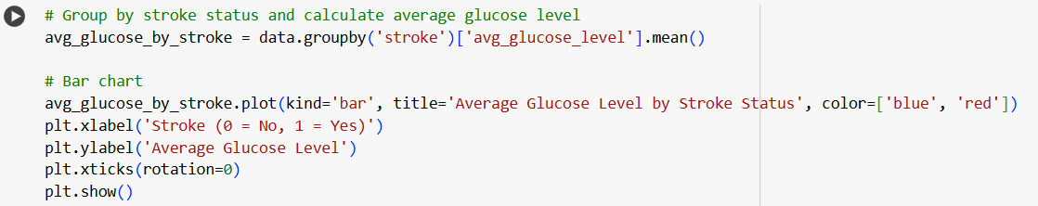
Average Glucose Level by Stroke Status
Visualization:
A bar chart comparing the average glucose levels for:
Individuals without stroke (Stroke = 0)
Individuals with stroke (Stroke = 1)
Insight:
Individuals with a stroke have significantly higher average glucose levels compared to those without a stroke.
This finding highlights the importance of monitoring and managing glucose levels as part of stroke prevention strategies.

Slide 11
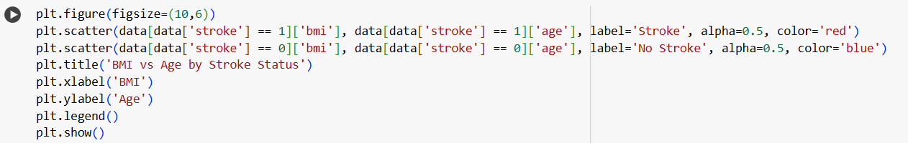
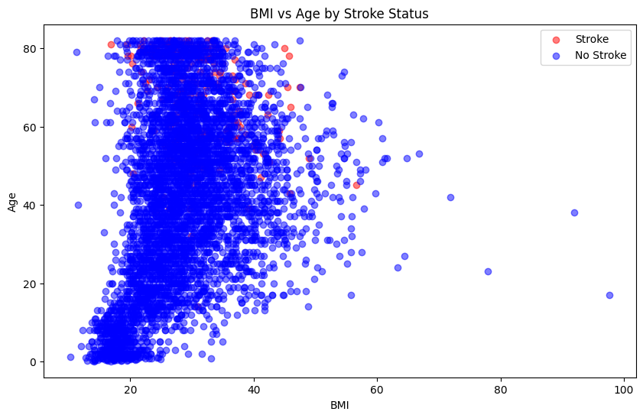
BMI vs Age
Objective: Investigate the relationship between BMI, age, and stroke occurrence.
Insights:
Stroke patients are concentrated in higher age groups and BMI ranges.
Non-stroke patients span all age and BMI categories.

Slide 12
Key Insights from Analysis
Gender Differences:
Females exhibited a slightly higher number of stroke cases compared to males.
This highlights the potential need for gender-specific healthcare interventions.
Smoking and Hypertension:
These are significant contributors to stroke occurrences.
Individuals with hypertension have a stroke proportion of 13% compared to 4% in non-hypertensive individuals.
Smoking history (especially "Formerly Smoked") correlates with increased stroke risk.
Glucose Levels:
Elevated glucose levels are strongly associated with stroke cases.
Managing glucose levels is critical for stroke prevention.

Slide 13
Conclusion
Targeting High-Risk Groups:
Focus on individuals with hypertension, a smoking history, and elevated glucose levels for preventive healthcare measures.
Gender-specific strategies may also enhance stroke prevention.
Dataset Analysis:
Analyzing healthcare data provides valuable insights into factors contributing to strokes.
This analysis highlights the importance of addressing conditions like hypertension and elevated glucose levels.
Future Scope:
Develop and implement machine learning models to predict stroke risk.
Integrate these models into healthcare systems for early detection and intervention.
.

Slide 14
THANK YOU

